Slide 1

Be Better Than Compliant
Tessa Darbyshire
Date:

Slide 2

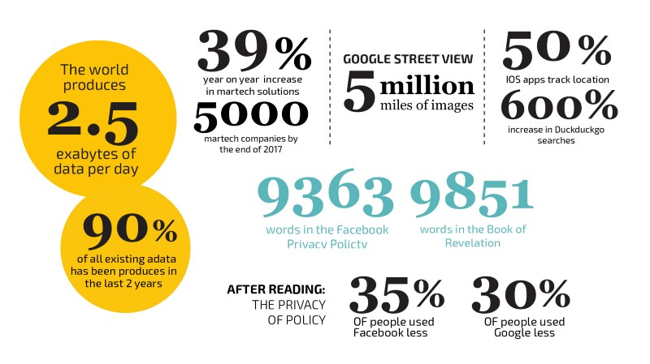
Trust and Privacy
Awareness of the importance of privacy is growing, as is the amount of data being produced.

Slide 3
Shifting Sands
Decreasing Trust
UK consumers have a low degree of trust in organisations to protect their digital data, with less than half of UK consumers (46%) willing to exchange personal data for free or discounted services.
Evolving Legislation
GDPR - General Data Protection Legislation
Cookie Law - Privacy and Electronic Communications Legislation
Notes:
Frost and Sullivan CA technologies
The Global State of Online Digital Trust 2018
Movement towards enforcement

Slide 4
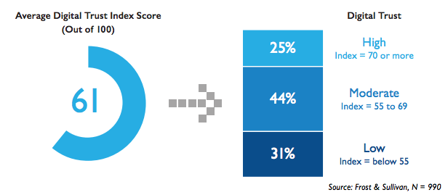
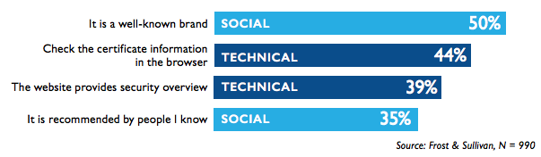
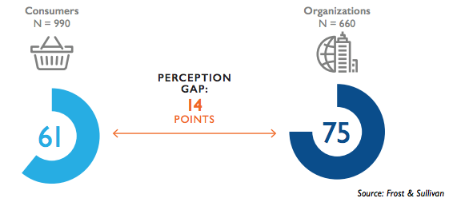
Gaps in Perception
While 43% of business executives say they sell PII.
Only 15% of information security professionals report that their organization sells PII to other organization.
This represents a 28 percentage point gap.
The impact on the bottom line comes as half of consumers indicated that they would leave a service provider after a data breach.
Notes:
Impact on bottom line as people leave

Slide 5
Requirements and Opportunities
Service providers need to demonstrate trustworthiness across all processes:
Security
Advertising
Branding
Corporate Social Responsibility
Industry standards
There are a range of actionable opportunities to showcase trustworthiness:
Be authentic
Highlight reputational history
Historical / Social Proof (Trust cues)
Transparency
Personal interaction
Notes:
https://www.forbes.com/sites/jaysondemers/2018/05/09/how-brands-should-be-working-to-fix-the-consumer-trust-crisis/#219f613a554c
https://www.computerweekly.com/news/252445947/UK-business-overestimating-level-of-consumer-trust-study-shows

Slide 6

How can brands get ahead of the shift?

Slide 7
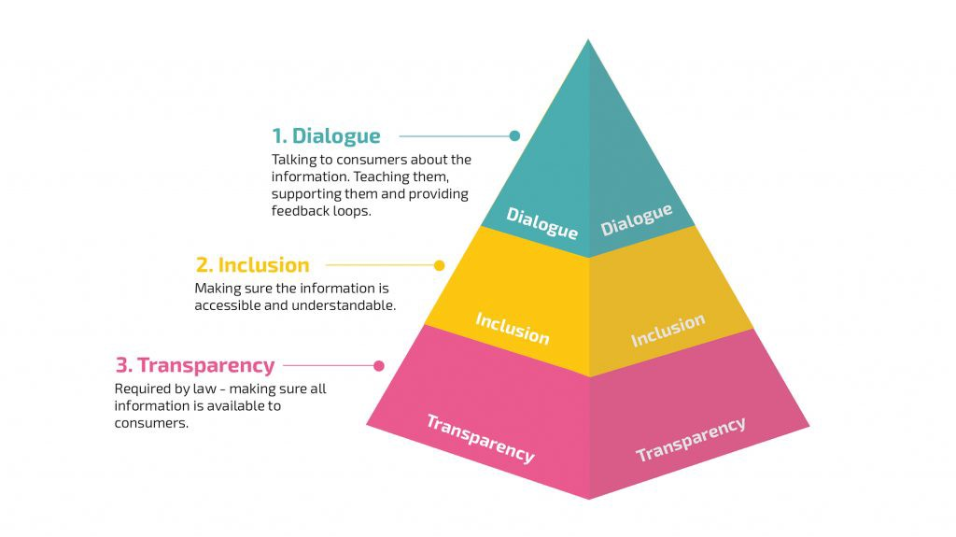
A New Trust Model
TASKS

Slide 8
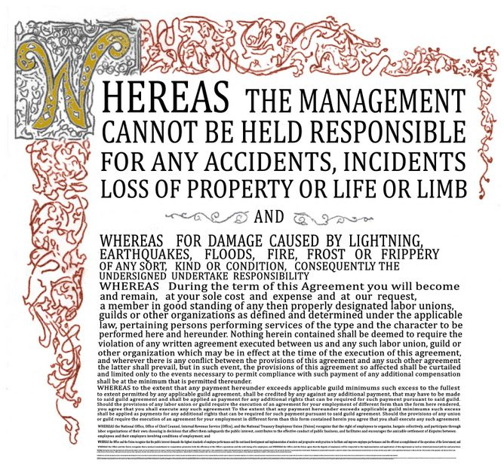
Notes:
The Amazon Kindle terms and conditions take 9 hours to read in full.

Slide 9
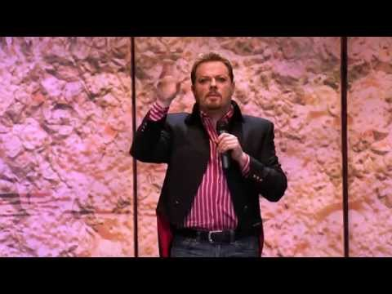

Slide 10
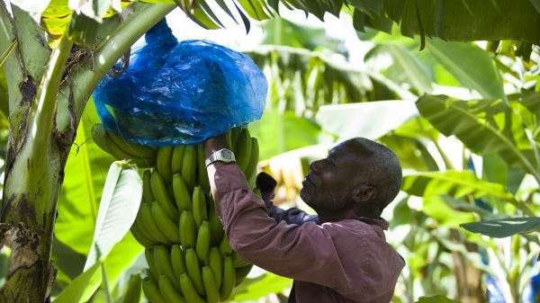

Start designing
trust cues
Notes:
Over a million small-scale producers and workers are organized in as many as 3,000 grassroots organisations

Slide 11
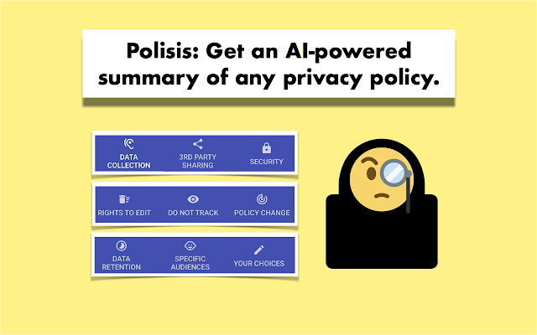
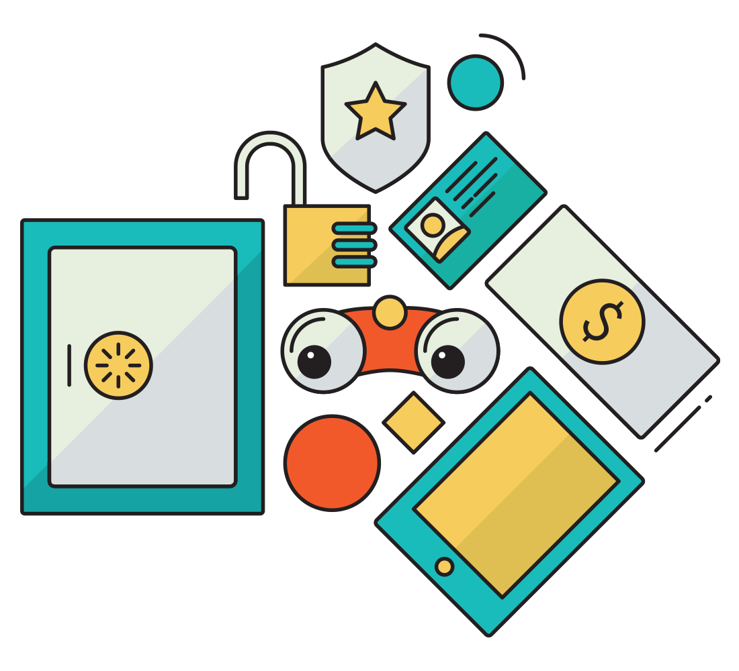





Market Analysis
TASKS
Automatic Processing Tools
Parsing Privacy Policies
Setting Standards
Notes:
Disconnect

Slide 12
Stakeholder Map
SERVICE PROVIDERS
LEGISLATORS &
RESEARCHERS
Simple to produce privacy policies
Improved consumer perception of brand
Increased resilience in shifting legislative environment
Better understanding of consumer desires
Standardised approach to policy structure
Automated approach to filtering through policies
USER
Personal data is protected
Preferences taken into account
Privacy policies made comprehensible

Slide 13
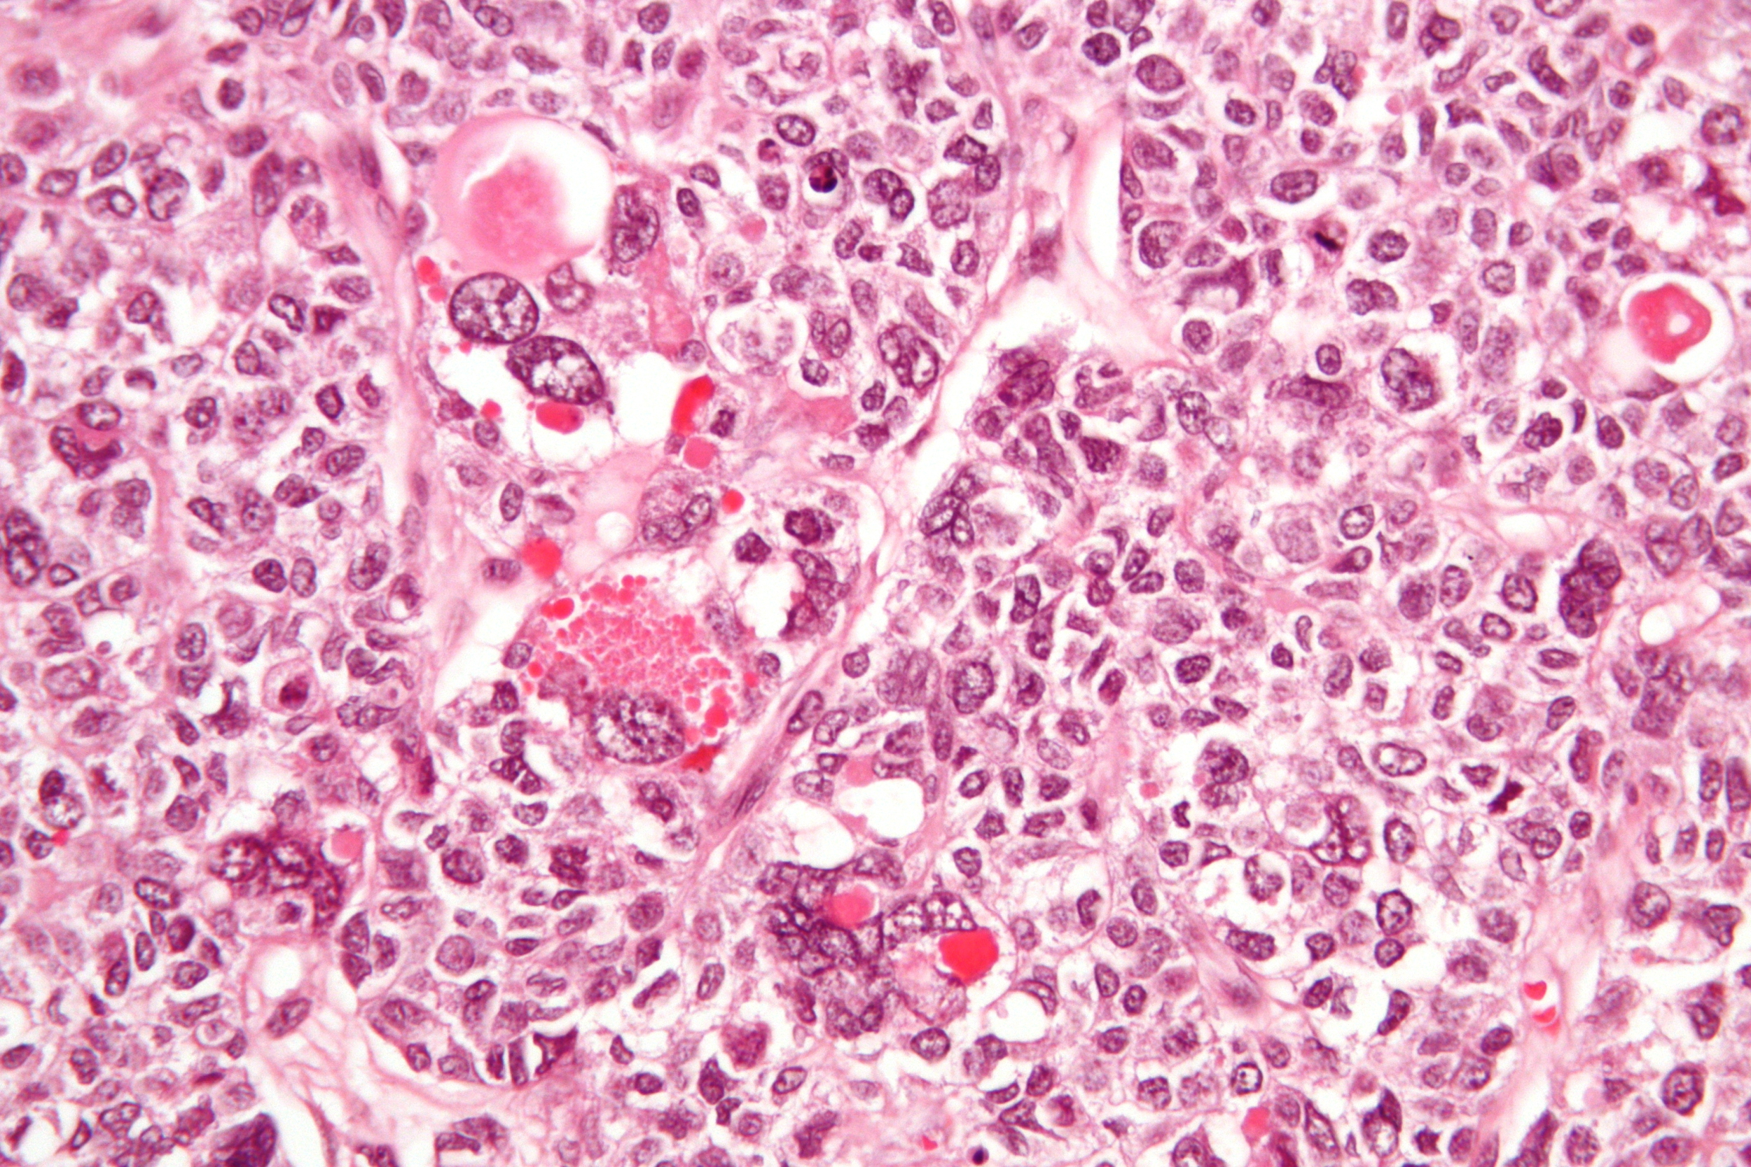
Challenge 1:
Parsing the Text

Slide 14
Parsing and Summarising
The language of privacy policies is specialised but not standardised
Policies are often long-winded, have varied structures and numerous ambiguities.
NLP is an option but required investment in training is large.
An algorithm isn’t a legal expert
Summaries / recommendations generated by automated processing cannot stand in for the advice of a lawyer.
Confidence scores provide some indication of this, but could also indicate deliberate obfuscation by the service provider.
Any framework we ask brands to enter their policy into needs to be legally sound.
Fancy having a go?

Slide 15
Wilson Annotation Scheme
Each data practices belongs to one of ten categories
1 - First Party Collection / Use
2 - Third Party Sharing / Collection
3 - User Choice / Control
4 - User Access, Edit and Deletion
5 - Data Retention
6 - Data Security
7 - Policy Change
8 - Do Not Track
9 - International & Specific Audiences
10 - Other
Each practise is then articulated using a category specific set of attributes
Under 3 - User Choice / Control
Mandatory attributes: choice type, choice scope, personal information type, purpose
Optional attributes: user type
Attribute set reflects different levels of specificity present in policies

Slide 16
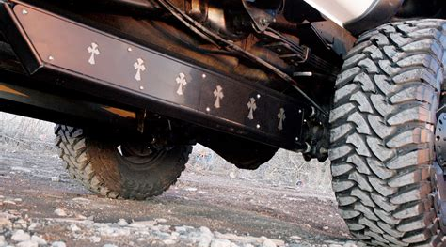
Challenge 2:
Gaining Traction

Slide 17
Why don’t the tools get used?
Answer:
Because humans are lazy.
Situations that are task oriented and time pressured demand the simplest solutions.
So tell us:
You’ve looked at the policy - which statements do you feel you care about?
Which statements do you care about enough to act on?

Slide 18

What’s the Utopia?

Slide 19
Possible Outcomes
Automated negotiation
Direction according to preferences
Wide range of channel / interface options
Personal data carrying its own permissions

Slide 20

Our Approach

Slide 21
Process
Brand sets switches
Machine generates policy
Generates comparative score
Machine compares
User sets preferences
Automatic acceptance if threshold met

Slide 22
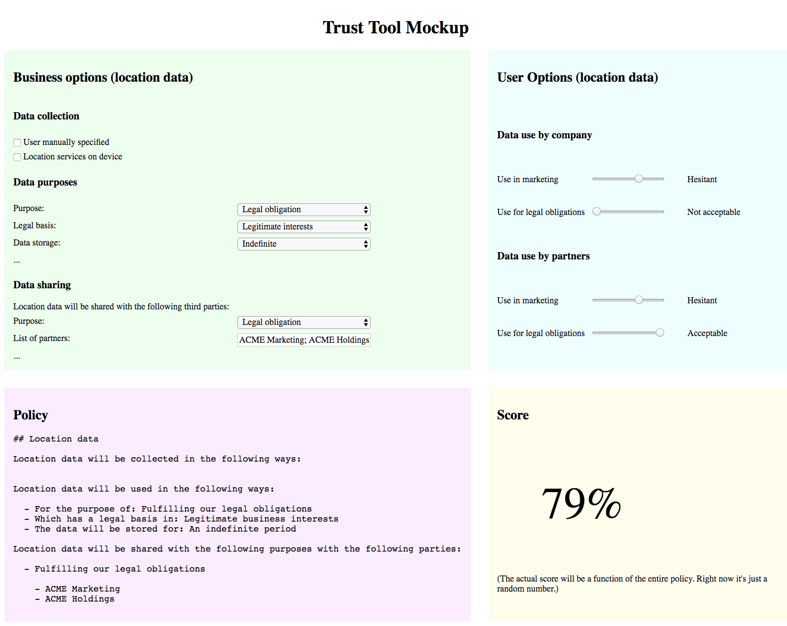

Slide 23
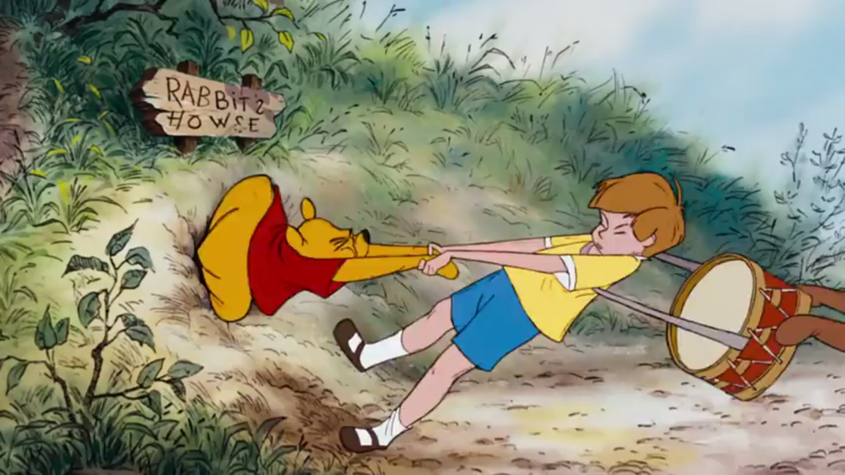
Get Stuck
In

Slide 24
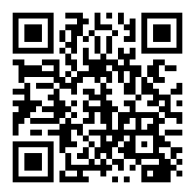
https://tedarbyshire.github.io/trust-tools/

